Slide 1
You Are Here- Interactive Exhibit
By Jordan Marks, Caitlin White, Ogheneochuko Ideh and Jamie Chandler

Slide 2
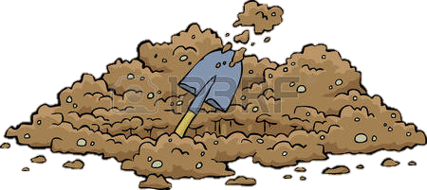
OVERVIEW
Interactive Map
‘Treasure Hunt’ mini game
Quiz
Informative
JM

Slide 3
GAME LOOP
Locate Dig Site
Tap to Dig
Artifact Unearthed
Fact and Question
Answer Question – Additional Info
CW

Slide 4
Heritage and Games
Heritage can benefit from gamification.
Gamification encourages engagement with product.
Resulting in increased retention.
OI

Slide 5

Character suggestion
Character representive of Ipswich/Museum
Adhere to a wide demographic
JC

Slide 6
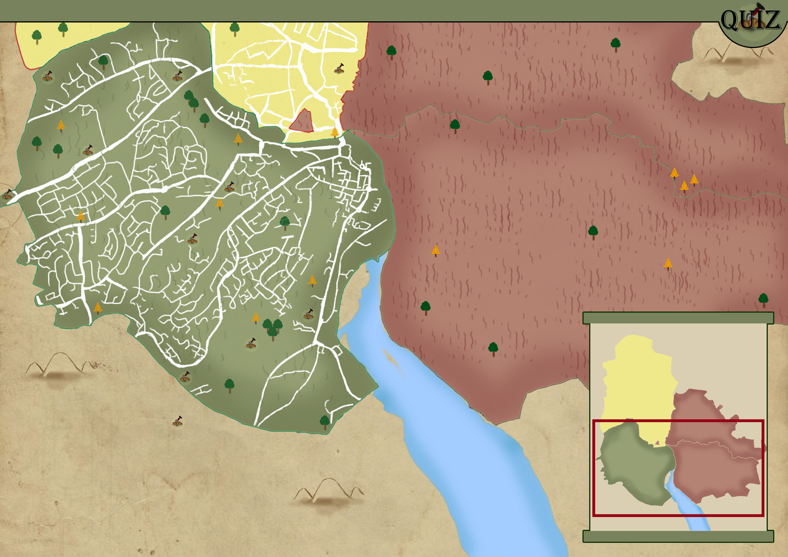
Screen mockups
OI
Notes:
https://pixabay.com/p-2237425/?no_redirect

Slide 7
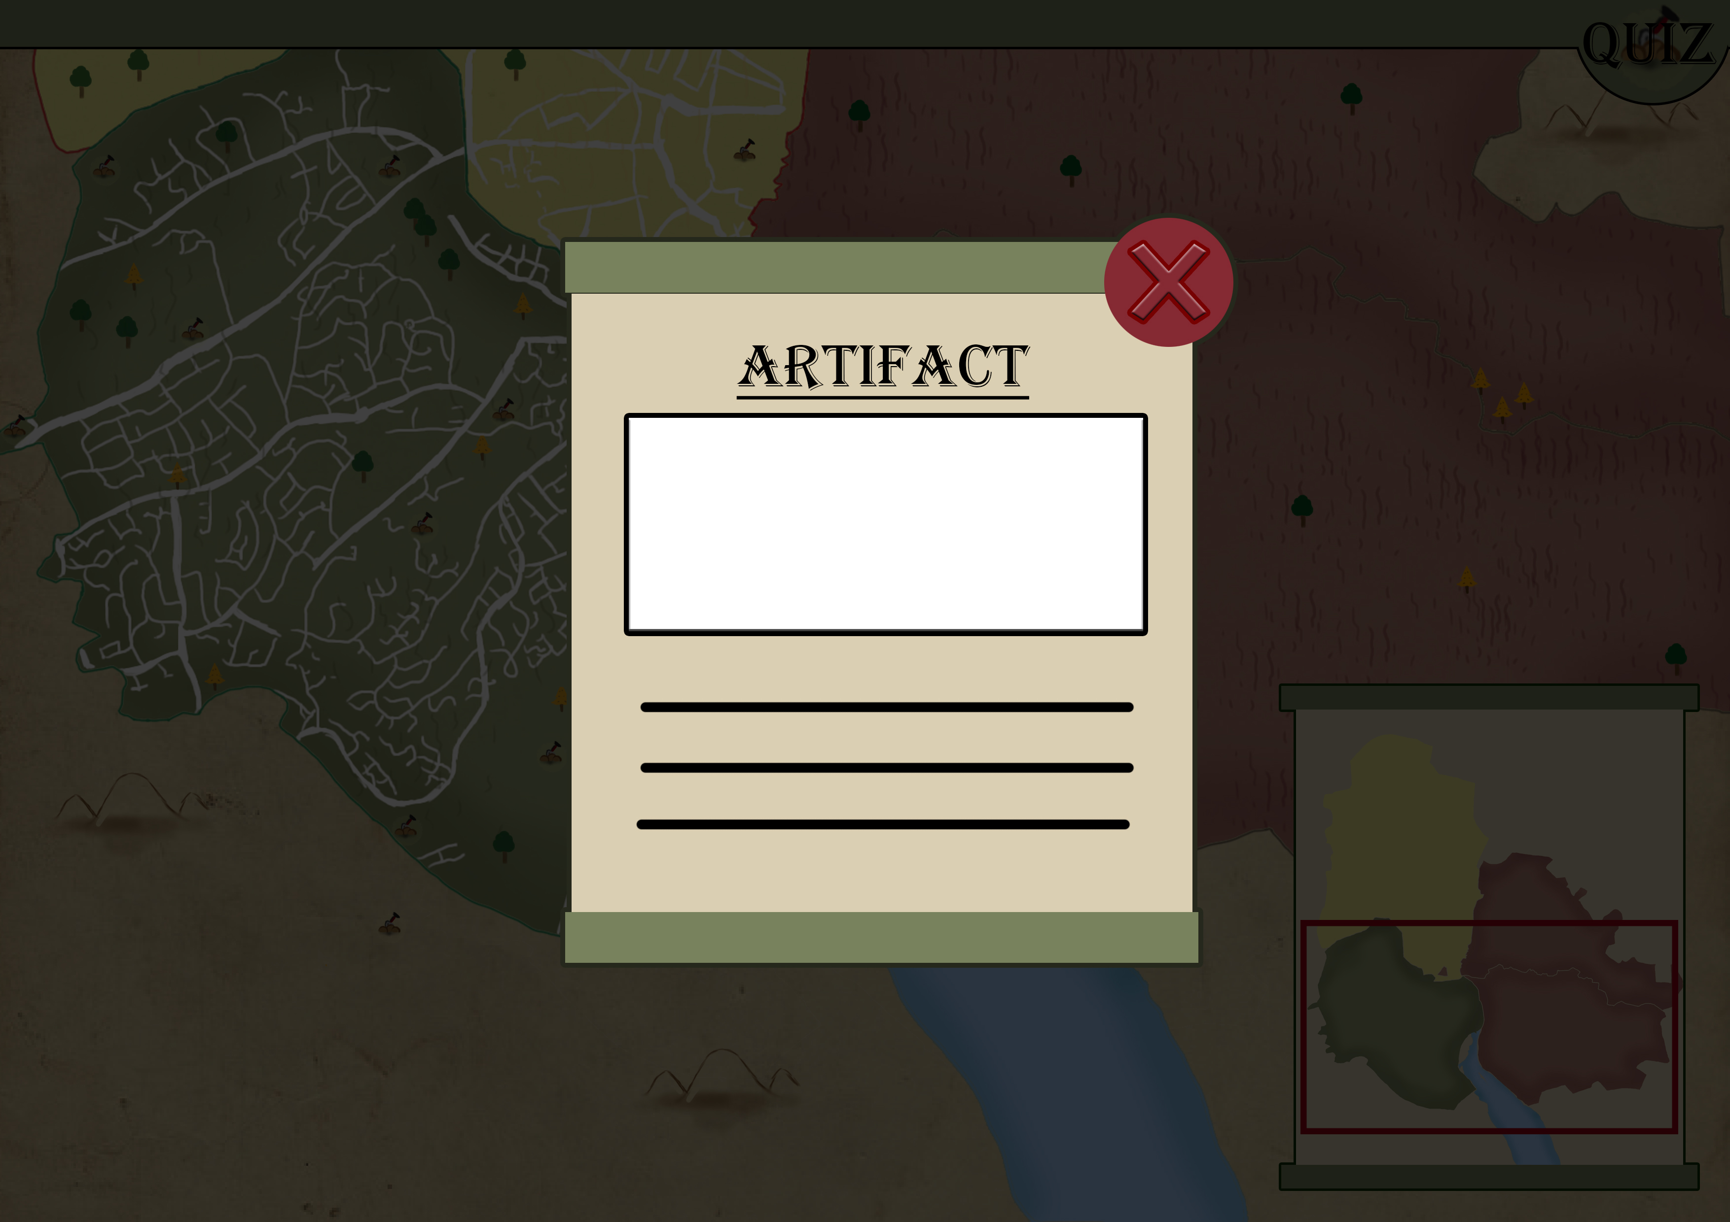
Screen mockups
JC
Notes:
https://pixabay.com/p-2237425/?no_redirect

Slide 8
PROJECT GOALS
Encourage thought and discussion
Provide facts
Through text (questions/answers)
Through the map (locations/pictures)
Simple and intuitive. Easy to use
CW

Slide 9
Estimated Delivery Timeframe
Week of | Art Milestones
6/11/2017 | First working prototype
27/11/2017 | Alpha Stage
18/12/2017 | Beta stage
JM

Slide 10
Question?

